Slide 1

Filesystems
An Introduction to Programming in Python
Notes:
Let's learn about Filesystems

Slide 2


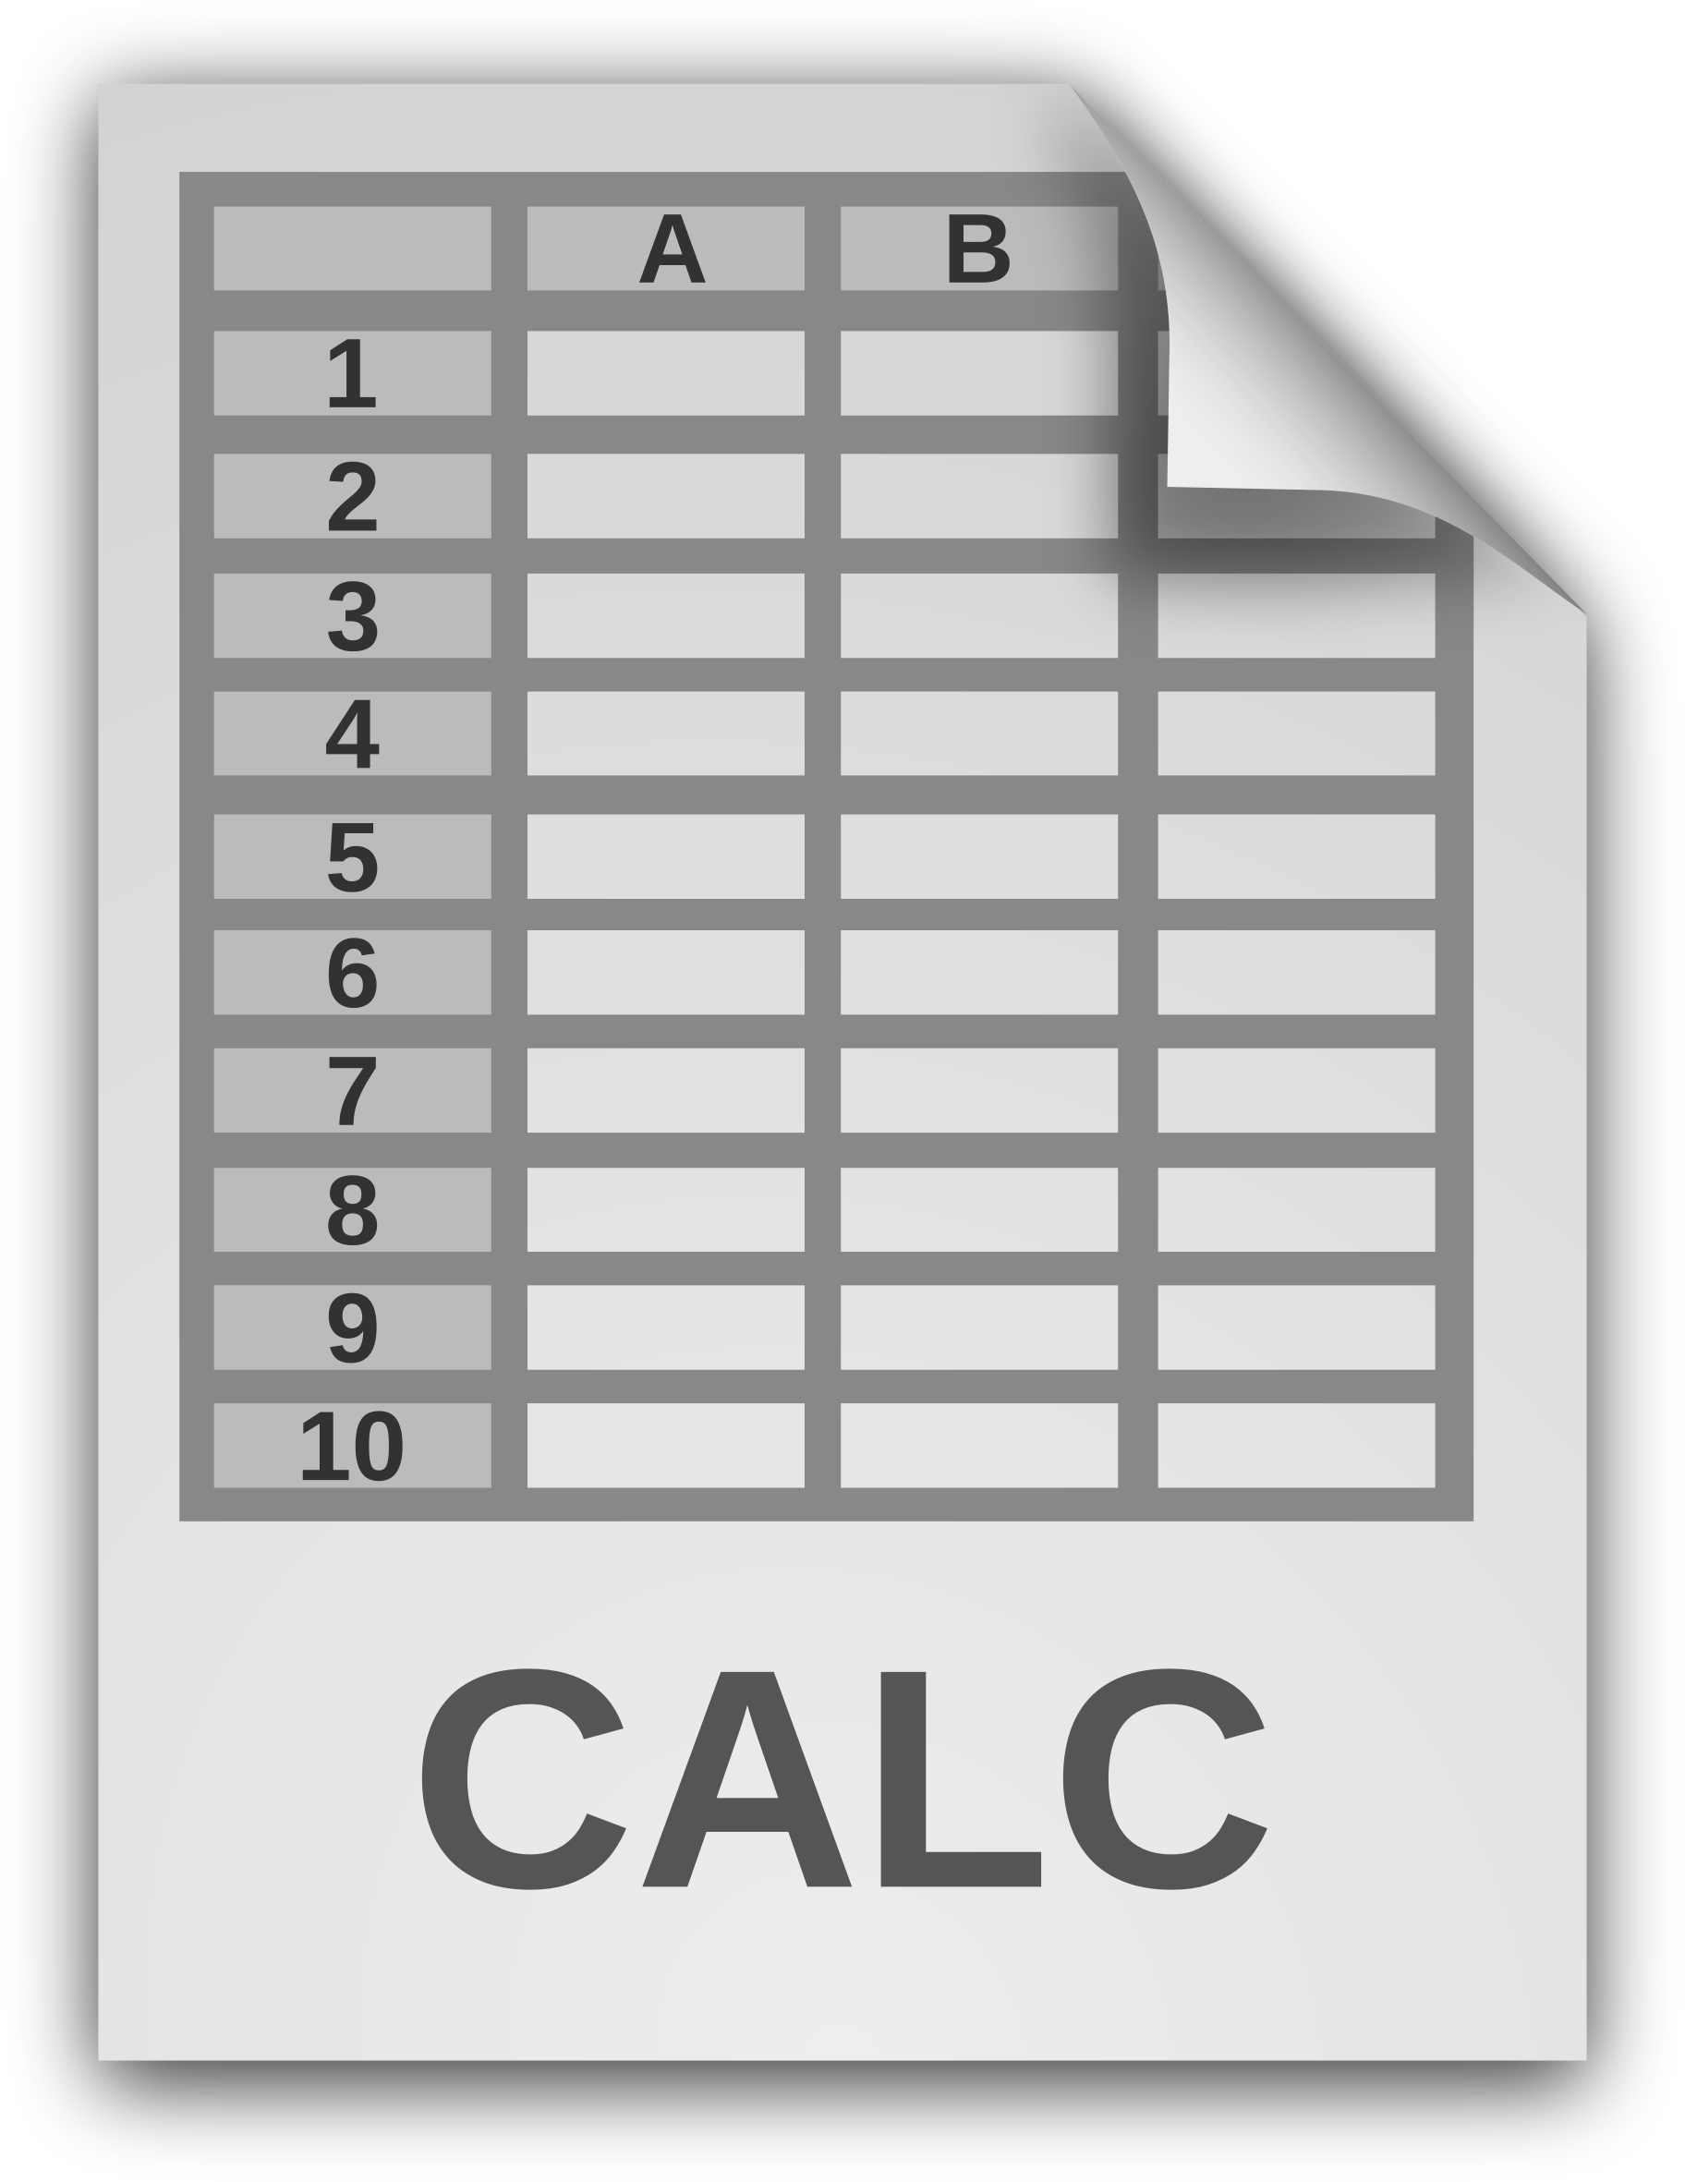


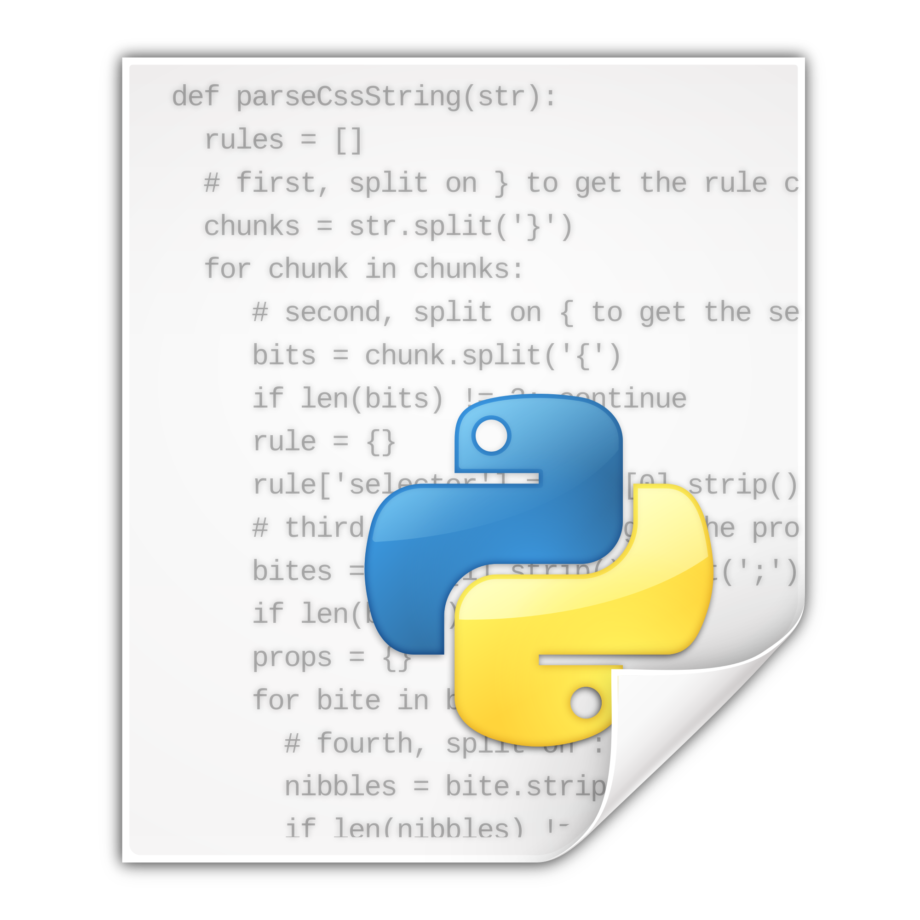
Files
Root
School work
Photos
Python
homework2.doc
cs10.xls
Photo1.jpg
Me_irl.jpg
strings.py
example.py
Notes:
Your computer is equipped with a filesystem that lets you save and load files.
A file is simply a sequence of data, not unlike a string.
You create files all the time - text documents, pictures, music, python files, and so on.
These files are organized by your File System.

Slide 3
Directories
Directories == Files
Notes:
Directories, also known as folders, are a way to group files and other directories together.
Because we can put directories inside of directories, we end up with a heirarchical system.

Slide 4
Paths
Path
Root
School work
Photos
Python
homework2.doc
cs10.xls
Photo1.jpg
Me_irl.jpg
strings.py
example.py
Notes:
Think of files as a house.
Directories are neighborhoods, cities, states, and successively bigger ways to group houses.
Each file has a unique address within your file system called its "path".
We use these paths to navigate files and directories, just like we would houses and neighborhoods.

Slide 5
Absolute Path
"/root/python/example.py"
Or maybe…
"/home/acbart/python/example.py"
Or maybe…
"C:/Users/acbart/python/example.py"
Notes:
The full address for a file is known as its "absolute path".
The exact format of the path will depend on your platform, but typically they are a series of folder names separated by slashes.
In Python, it is typically best to use forward slashes, since these tend to work regardless of the platform.

Slide 6
The Working Directory
>>> pwd
'C:\\Users\\acbart\\Documents'
Two slashes? The first one is an escape character, which means this is really only ONE slash!
Notes:
Command lines that interact with file systems have a Current Working Directory.
It's essentially "where you are" at the moment.
In IPython, you can check your current directory using the "pwd" command.
PWD stands for Print Working Directory.

Slide 7
Relative Paths
>>> ls
Date Time Type Size Name
09/17/2017 09:41 PM <DIR> .
09/17/2017 09:41 PM <DIR> ..
09/12/2017 03:11 PM <DIR> photos
09/14/2017 05:34 PM <DIR> music
09/11/2017 02:45 PM <DIR> python
09/02/2016 06:08 PM 6,228 homework5.pdf
09/02/2016 06:08 PM 9,650 example.py
08/08/2015 07:43 PM 340,489 historyOfDogs.png
08/08/2015 07:44 PM 422,316 taxReturns.docx
Formats vary by operating system!
Notes:
If there are folders in your current working directory, you can reference them without writing the Absolute path.
Instead, the folder's path is simply it's name.
You can see a list of the folders in your current directory by using the "ls" command.
LS stands for "list", as in "list the files".

Slide 8
Moving between directories
>>> cd C:/Users/acbart/projects
>>> cd pythonmisc/
>>> cd ../
Absolute Path
Relative Path
Move up a level
Notes:
To move from one directory to another, we use the "cd" command.
You can move to an absolute path or a relative path.
You can also move up a folder level by using a pair of periods.

Slide 9
Commands
Command | Description
pwd | print current working directory
ls | list files in current working directory
ls <path> | list files in the directory of the path
cd <path> | change the current working directory to that path
Notes:
It can be tricky to remember these commands, but knowing how to use them will serve you well when you start working on larger projects.

